Slide 1




Luke Palmer,
Academic Background
Associate Research Fellow at Camborne School of Mines, University of Exeter, as part of EU funded STOICISM project. Led by IMERYS minerals Ltd., total budget 6€m, focusing on Improved Process Control of Calcined Industrial Minerals in Europe
MSc at Camborne School of Mines, University of Exeter; Mining Geology
BSc at University of Bristol; Archaeological Sciences
Resource Scarcity: Securing a Sustainable Development of Mineral Resource Base of Kazakhstan

Slide 2
The Role of Geostatistics in the Mining Value Chain
If we want to extract an resource in the most efficient way, then we need to know the distribution of grades and tonnage within it.
Geostatistics definition: A group of techniques based on variography to describe variables with a spatial component; for example grade, density, hardness.
The role of Geostatistics has become increasingly important throughout the mineral extractive industry
Two of the purposes of geostatistics is to produce estimates and simulations of mineral deposits.
Exploration
Deposit
Scoping
Mine Design
Mine Scheduling
Mining
Closure/ remediation
Notes:
Def Geostatistics:
The role of Geostatistics has become increasingly important throughout the mineral extractive industry
Overview of est and sim

Slide 3
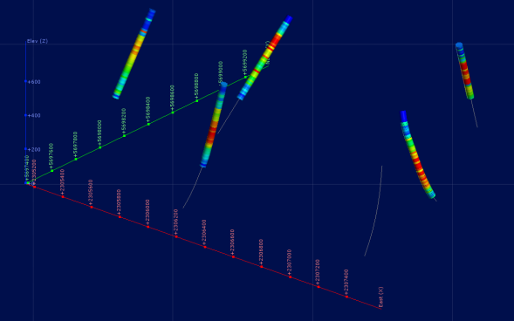
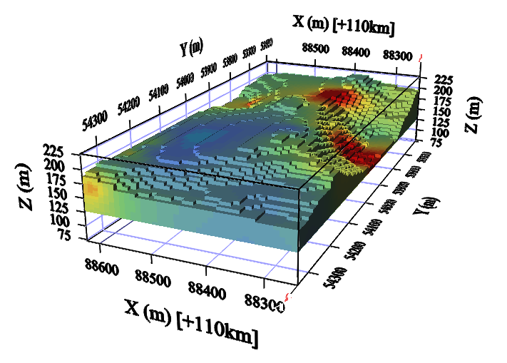
My Geostatistics Research: Robust Estimation of Grade and Tonnage
Robust estimation of grade and tonnage is key to energy efficient mining and exploration practice.
Developing methodologies
Application of novel estimation techniques.
Estimation of non-traditional variables.
Analysis of how the change in inputs affects the final result.
Incorporating geological information into geostatistical practice.
Palmer LW and Glass HJ (2015) Comparison of Grade Modelling Methods at Blackpool China Pit, Cornwall, Geoscience in South-West England, Vol 13 (4): 454-458.
Palmer LW and Glass HJ (2015) Indicator-Based Characterisation of Kaolin Deposits Proceeding of the 13th Biennial Society for Geology Applied to Ore Deposits Meeting, 24-27 August 2015, Nancy, France, pp1323-1327.

Slide 4
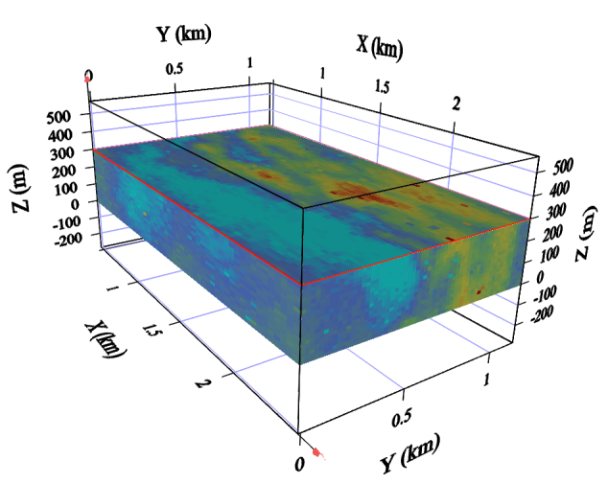
My Geostatistics Research: Accessing efficiency of Rock Type Prediction using Simulation
Simulation can be used to assess the risk associated with a estimation.
Comparison of conditional simulation techniques for accessing their ability to predict lithologies across a deposit.
Creation of risk models based on probability of occurrence of key lithology.
Conclusion that some inputs are more sensitive to change than others and can cause unnatural risk models to be produced.
Palmer LW and Glass HJ. (2014) Risk associated with rock type prediction using simulation techniques, 9th International Mining Geology conference, Adelaide, Australia, AusIMM, publ. series no 7/2014, Adelaide, pages 217-227

Slide 5
Geometallurgy; Defining Deposits through Process Response
Geometallurgy is a catch all term that has come to define a modern way of thinking about mineral deposits in terms of non-traditional properties, such as grade and tonnage.
Instead, deposits are characterised by properties that have a direct bearing on how the deposit will be extracted.
These can be in terms mining (blastability), mineral processing (mineral liberation, grindability), geotechnical engineering (rock mass designation), environmental engineering (acid producing potential, fines producing potential) etc.
It aims to generate correlations between properties and link them back to the geology and the processes that formed them.
My research focuses on characterisation of deposits through mineral processing techniques to enable greater operation flexibility and energy saving to ensure that the ore is correctly identified and processed.
Characterisation of key geometallurgical variables
Estimation across deposit using geostatistics
Reconciliation between estimation and production data
Palmer LW, Colgan BL and Glass HJ (2016) Ore Characterisation of Perlite for Process Optimisation, Physio-Chemical Problems in Mineral Processing In review.

